Slide 1

DeepSORT
A Deep Dive

Slide 2

Introduction

Slide 3

Object detection vs Object Tracking
These days with the jargon surrounding deep learning, terms and their meanings tend to get mixed up, causing immense confusion to a new learner.
So, what’s the difference between “Object Detection” and “Object Tracking” ?

Slide 4

Object detection
In object detection, we detect an object in a frame, put a bounding box or a mask around it and classify the object.
Note that, the job of the detector ends here. It processes each frame independently and identifies numerous objects in that particular frame.

Slide 5

Object Tracking
Now, an object tracker on the other hand needs to track a particular object across the entire video.
If the detector detects 3 cars in the frame, the object tracker has to identify the 3 separate detections and needs to track it across the subsequent frames (with the help of a unique ID).

Slide 6

Deep SORT

Slide 7
DeepSORT
The most popular and one of the most widely used, elegant object tracking framework is Deep SORT, an extension to SORT (Simple Real time Tracker).
We shall go through the concepts introduced in brief and delve into the implementation.

Slide 8

The Kalman Filter
Our friend from above, Kalman filter is a crucial component in deep SORT.

Slide 9

What is it?
Kalman filters are ideal for systems which are continuously changing.
They have the advantage that they are light on memory (they don’t need to keep any history other than the previous state), and they are very fast, making them well suited for real time problems and embedded systems.

Slide 10
The Kalman Filter
Our state contains 8 variables: (u,v,a,h,u’,v’,a’,h’)
where (u,v) are centres of the bounding boxes, a is the aspect ratio and h, the height of the image.
The other variables are the respective velocities of the variables.

Slide 11

The Kalman filter
The variables have only absolute position and velocity factors, since we are assuming a simple linear velocity model.

Slide 12

The Kalman filter
The Kalman filter helps us factor in the noise in detection and uses prior state in predicting a good fit for bounding boxes.

Slide 13
The Kalman Filter
For each detection, we create a “Track”, that has all the necessary state information.
It also has a parameter to track and delete tracks that had their last successful detection long back, as those objects would have left the scene.

Slide 14

The assignment problem
Now that we have the new bounding boxes tracked from the Kalman filter, the next problem lies in associating new detections with the new predictions.

Slide 15

The assignment problem

Slide 16

The assignment problem
Since they are processed independently, we have no idea on how to associate track_i with incoming detection_k.

Slide 17

The assignment problem
To solve this, we need 2 things: A distance metric to quantify the association and an efficient algorithm to associate the data.

Slide 18

The distance metric

Slide 19

The distance metric
The authors decided to use the squared Mahala Nobis distance (effective metric when dealing with distributions) to incorporate the uncertainties from the Kalman filter.

Slide 20

The distance metric
Thresholding this distance can give us a very good idea on the actual associations.
This metric is more accurate than say, Euclidean distance as we are effectively measuring distance between 2 distributions (remember that everything is distribution under Kalman!)

Slide 21

What’s wrong with using Euclidean Distance for Multivariate data?

Slide 22
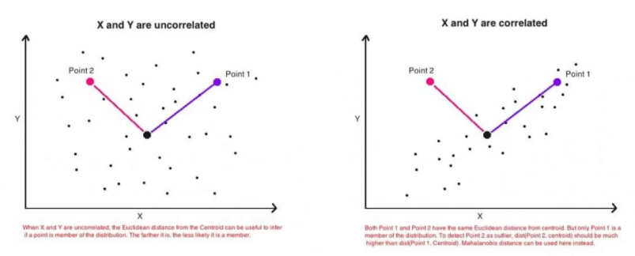
the Euclidean distance between a point and the center of the points (distribution) can give little or misleading information about how close a point really is to the cluster.

Slide 23
The Euclidean Distance
The above image (on the right) is a simple scatterplot of two variables that are positively correlated with each other.
That is, as the value of one variable (x-axis) increases, so does the value of the other variable (y-axis).

Slide 24
The Euclidean Distance
The two points above are equally distant (Euclidean) from the center.
But only one of them (blue) is actually more close to the cluster, even though, technically the Euclidean distance between the two points are equal.

Slide 25
The Euclidean Distance
This is because, Euclidean distance is a distance between two points only.
It does not consider how the rest of the points in the dataset vary.
So, it cannot be used to really judge how close a point actually is to a distribution of points.

Slide 26
What is Mahala Nobis Distance?
Mahal Nobis distance is the distance between a point and a distribution, and not between two distinct points.
It is effectively a multivariate equivalent of the Euclidean distance.

Slide 27
What is Mahala Nobis Distance?
So computationally, how is Mahala Nobis distance different from Euclidean distance?
1- It transforms the columns into uncorrelated variables
2- Scale the columns to make their variance equal to 1
3- Finally, it calculates the Euclidean distance.

Slide 28
What is Mahala Nobis Distance?
The above three steps are meant to address the problems with Euclidean distance we just talked about. But how?

Slide 29
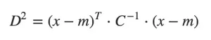
The math and intuition behind Mahala Nobis Distance
The formula to compute Mahala Nobis distance is as follows:
where, - D^2 is the square of the Mahala Nobis distance. - x is the vector of the observation (row in a dataset), - m is the vector of mean values of independent variables (mean of each column), - C^(-1) is the inverse covariance matrix of independent variables.

Slide 30
So, What is the effect of dividing by the covariance?
If the variables in your dataset are strongly correlated, then, the covariance will be high.
Dividing by a large covariance will effectively reduce the distance.
Likewise, if the X’s are not correlated, then the covariance is not high and the distance is not reduced much.

Slide 31
So, What is the effect of dividing by the covariance?
So effectively, it addresses both the problems of scale as well as the correlation of the variables that we talked about earlier.

Slide 32

The efficient algorithm

Slide 33
The Hungarian Algorithm
In this case, we use the standard Hungarian algorithm, which is very effective and a simple data association problem.

Slide 34
The Hungarian Algorithm
The Hungarian algorithm consists of the four steps below.
The first two steps are executed once, while Steps 3 and 4 are repeated until an optimal assignment is found.
The input of the algorithm is an n by n square matrix with only non-negative elements.

Slide 35
Step 1: Subtract row minima
For each row, find the lowest element and subtract it from each element in that row.

Slide 36
Step 2: Subtract column minima
Similarly, for each column, find the lowest element and subtract it from each element in that column.

Slide 37
Step 3: Cover all zeros with a minimum number of lines
Cover all zeros in the resulting matrix using a minimum number of horizontal and vertical lines.
If n lines are required, an optimal assignment exists among the zeros. The algorithm stops.
If less than n lines are required, continue with Step 4.

Slide 38
Step 4: Create additional zeros
Find the smallest element (call it k) that is not covered by a line in Step 3.
Subtract k from all uncovered elements, and add k to all elements that are covered twice.

Slide 39
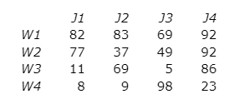
The Hungarian algorithm: An example
We consider an example where four jobs (J1, J2, J3, and J4) need to be executed by four workers (W1, W2, W3, and W4), one job per worker.
The matrix below shows the cost of assigning a certain worker to a certain job.
The objective is to minimize the total cost of the assignment.

Slide 40
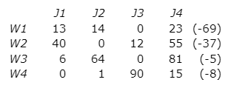
Step 1: Subtract row minima
We start with subtracting the row minimum from each row.
The smallest element in the first row is, for example, 69.
Therefore, we subtract 69 from each element in the first row. The resulting matrix is:

Slide 41
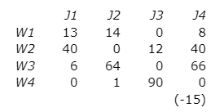
Step 2: Subtract column minima
Similarly, we subtract the column minimum from each column, giving the following matrix:

Slide 42
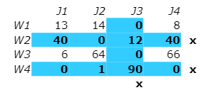
Step 3: Cover all zeros with a minimum number of lines
We will now determine the minimum number of lines (horizontal or vertical) that are required to cover all zeros in the matrix.
All zeros can be covered using 3 lines:

Slide 43
Step 3: Cover all zeros with a minimum number of lines
Because the number of lines required (3) is lower than the size of the matrix (n=4), we continue with Step 4.

Slide 44
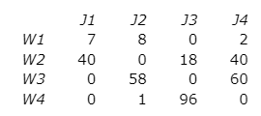
Step 4: Create additional zeros
First, we find that the smallest uncovered number is 6.
We subtract this number from all uncovered elements and add it to all elements that are covered twice.
This results in the following matrix:

Slide 45
Step 4: Create additional zeros
Now we return to Step 3.

Slide 46
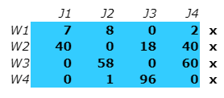
Step 3: Cover all zeros with a minimum number of lines
Again, We determine the minimum number of lines required to cover all zeros in the matrix.
Now there are 4 lines required:

Slide 47
Step 3: Cover all zeros with a minimum number of lines
Because the number of lines required (4) equals the size of the matrix (n=4), an optimal assignment exists among the zeros in the matrix.
Therefore, the algorithm stops.

Slide 48
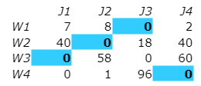
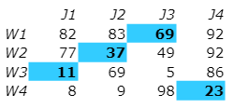
The optimal assignment
The following zeros cover an optimal assignment:
This corresponds to the following optimal assignment in the original cost matrix:

Slide 49
The optimal assignment
Thus, worker 1 should perform job 3, worker 2 job 2, worker 3 job 1, and worker 4 should perform job 4.
The total cost of this optimal assignment is to 69 + 37 + 11 + 23 = 140.

Slide 50

Where is deep learning in all this?

Slide 51
Where is deep learning in all this?
Well, we have an object detector giving us detections, Kalman filter tracking it and giving us missing tracks, the Hungarian algorithm solving the association problem.
So, is deep learning really needed here ?

Slide 52
Where is deep learning in all this?
The answer is Yes.
Despite the effectiveness of Kalman filter, it fails in many of the real world scenarios , like occlusions, different view points etc.

Slide 53
Where is deep learning in all this?
So, to improve this, the authors of Deep sort introduced another distance metric based on the “appearance” of the object.

Slide 54

The appearance feature vector

Slide 55
The appearance feature vector
The idea to obtain a vector that can describe all the features of a given image is quite simple.

Slide 56
The appearance feature vector
We first build a classifier over our dataset, train it till it achieves a reasonably good accuracy, and then strip the final classification layer.

Slide 57
The appearance feature vector
Assuming a classical architecture, we will be left with a dense layer producing a single feature vector, waiting to be classified.
That feature vector becomes our “appearance descriptor” of the object.

Slide 58
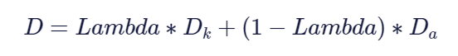
The appearance feature vector
Now, the updated distance metric will be :

Slide 59
The appearance feature vector
Where Dk is the Mahala Nobis distance and Da is the cosine distance between the appearance feature vectors and Lambda is the weighting factor.

Slide 60

The appearance feature vector
The importance of Da is so high, that the authors make a claim saying, they were able to achieve state of the art even with Lambda=0, only using Da!!

Slide 61
The appearance feature vector
A simple distance metric, combined with a powerful deep learning technique is all it took for deep SORT to be an elegant and one of the most widespread Object trackers.

Slide 62

Code Review

Slide 63
Code Review
In this section, we shall implement our own generic object tracker on a vehicle dataset.

Slide 64
Code Review
Now, since we are interested in creating an object tracker and not a detector, we shall use a video with pre-existing detection outputs.
Our repo has a video with detection boxes from YOLO, SSD and Mask-RCNN.

Slide 65
Code Review
Let us look at deepsort.py in detail.

Slide 66
class deepsort_rbc(): def __init__(self): #loading this encoder is slow, should be done only once. self.encoder = torch.load('model640.pt') self.encoder = self.encoder.cuda() self.encoder = self.encoder.eval() print("Deep sort model loaded") self.metric = nn_matching.NearestNeighborDistanceMetric("cosine",.5 , 100) self.tracker= Tracker(self.metric) self.gaussian_mask = get_gaussian_mask().cuda()

Slide 67
Deepsort.py
The self.encoder variable of the class loads the feature extractor once an object of this class is created.
We need to make sure that we load this instance only once, for a run.

Slide 68
Deepsort.py
The self.metric variable defines the distance metric to be used in the Hungarian algorithm for the data association problem.

Slide 69
Deepsort.py
self.tracker is an object of the class Tracker defined in the deep_sort library, that takes care of creation, keeping track and eventual deletion of all tracks.

Slide 70
Deepsort.py
self.gaussian_mask is our not so important creation, that we shall not talk about in this section.

Slide 71
Deepsort.py
#Initialize deep sort object. deepsort = deepsort_rbc(wt_path='ckpts/model640.pt') #path to the feature extractor model. #Obtain all the detections for the given frame. detections,out_scores = get_gt(frame,frame_id,gt_dict) #Pass detections to the deepsort object and obtain the track information. tracker,detections_class = deepsort.run_deep_sort(frame,out_scores,detections) #Obtain info from the tracks. for track in tracker.tracks: bbox = track.to_tlbr() #Get the corrected/predicted bounding box id_num = str(track.track_id) #Get the ID for the particular track. features = track.features #Get the feature vector corresponding to

Slide 72
Deepsort.py
run_deep_sort is the main function of this class, that we would be using. It takes in the frame, the detected bounding boxes and their confidence scores and returns an instance of the Tracker class that has all the info pertaining to the current tracks.

Slide 73
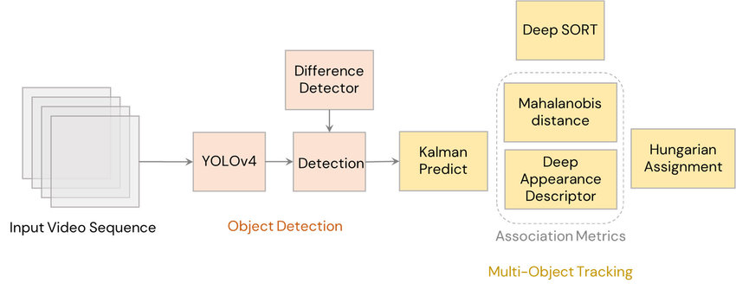
DeepSORT architecture

